Slide 1
Parch & Posey Dataset Analysis
CDE Circle 7
Fatima Idris
Temitope Fafure
Ayodeji Agunbiade
Godsgift Olomu
Keletso Ntseno

Slide 2


Overview
CoreDataEngineers is diversifying into the sales of goods and services. To understand the competitive landscape, we analyzed Parch and Posey, a major competitor. Using PostgreSQL, we explored their sales, accounts, sales representatives, regions, and web events data to answer key business questions and uncover insights.
accounts – company accounts with details of sales representatives
orders – all product orders with quantities and revenue
region – sales regions
sales_reps – sales representatives assigned to accounts and regions
web_events – customer interactions across web channels

Slide 3

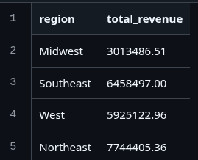
Fatima Idris
Regional Revenue Analysis: Northeast led with $7.74M, followed by Southeast ($6.45M), West ($5.92M), and Midwest ($3.01M).
Web Engagement vs Orders Analysis: Accounts with more web events generated higher revenue; e.g., account 4211 had 89 events → $382K.
Monthly Revenue Trend Analysis: Revenue peaked at $377K (Dec 2013), $682K (Nov 2015), and $1.77M (Dec 2016), then dropped in Jan 2017 ($78K).
Top Sales Representatives Analysis: Earlie Schleusner (Southeast) led with $1.09M, followed by Tia Amato (Northeast) with $1.01M, and Vernita Plump (Southeast) with $934K.
Top Accounts by Orders Analysis: Leucadia National had the most orders (71), followed by Sysco (68), Supervalu (68), Arrow Electronics (67), and Archer Daniels Midland (66).

Slide 4
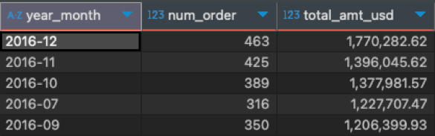
Ayodeji Agunbiade
Accounts with orders greater than 65 – Leucadia National placed the highest order
Accounts that placed an order in 2016 but not in 2017 – Top 5 accounts didn’t place an order in 2017
Account with the most order amount – EOG Resources (382,783)
Accounts with sales reps from Northeast – 106 accounts
Month of the year with the highest total amount in USD – Top 5 months with highest totals

Slide 5
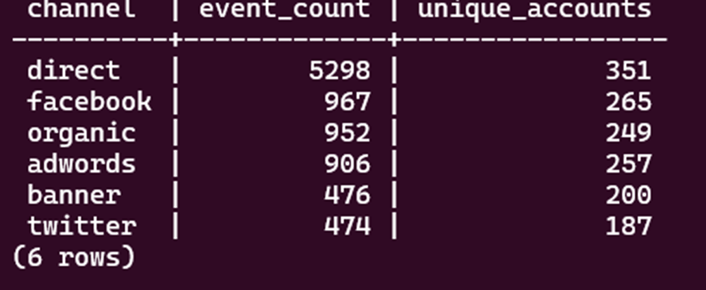
Godsgift Olomu
Insight: Standard paper leads overall sales, while gloss and poster make up smaller portions.
Insight: EOG Resources emerges as the largest revenue-contributing customer.
Insight: Direct and Facebook remain the strongest drivers of web traffic.
Insight: The Northeast region holds the highest concentration of accounts and sales reps.
Insight: Most orders fall under the Small size category.
Insight: Monthly analysis shows peak revenue in Dec 2013, while peak order volume occurred in Aug 2014.

Slide 6
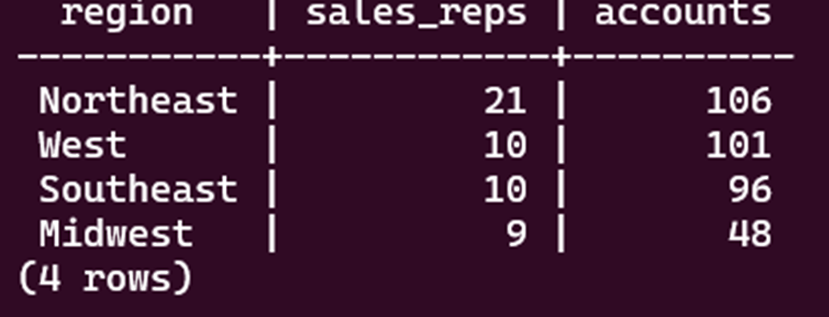
Temitope Fafure
High-Volume Orders Pattern: Found 14 orders with gloss/poster quantities exceeding 4000 units. These represent bulk purchases from enterprise clients.
Strategic Customer Segments: 2 companies starting with 'C' or 'W' have contacts with 'ana' pattern. These companies show consistent ordering patterns.
Regional Distribution : North east region has highest account concentration with 106 accounts. Total of 351 accounts across 4 regions.

Slide 7
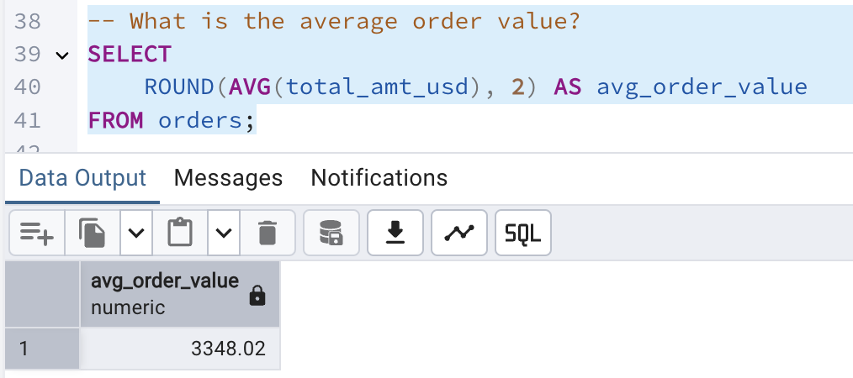
Keletso Ntseno
The top 5 customers generate significantly higher revenue compared to others, with the highest-performing customer contributing substantially more than the rest.
The client base shows a highly concentrated geographic distribution, with a few regions accounting for the majority of customers.
Portfolio distribution among sales professionals appears uneven, with a small group managing disproportionately large client portfolios.
The transaction size distribution shows a pattern where most transactions fall within a moderate range, with fewer very small or very large transactions

Slide 8
Thank you!

